Slide 1



Lecture – 6 Introduction To file System and permissions to a file
LINUX ADMINISTRATION
1

Slide 2

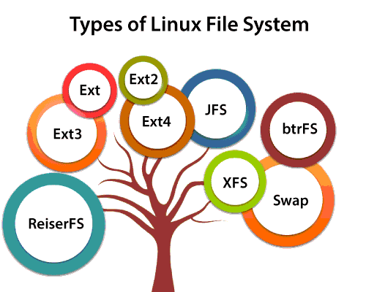

What is File system?
A file system is a method and data structure that the operating system uses to control how data is stored and retrieved.
It helps to arrange the file on the disk storage.
It manages the file name, file size, creation date, and much more information about a file.
Types of Linux File System

Slide 3
Ext (extended file system)
Created in 1992.
It was primarily developed for MINIX OS.
The very first file system designed specifically for Linux.
The Ext file system is an older version, and is no longer used due to some limitations.
Ext2 (Second extended file system)
Created in 1993.
Ext2 is the first Linux file system that allows managing two terabytes of data.
Ext3 (Third extended file system)
Created in 2001.
It is a journaling file system.

Slide 4
The major drawback of Ext3 is that it does not support servers because this file system does not support file recovery and disk snapshot.
Ext4(fourth extended system)
Created in 2006.
It is the faster file system among all the Ext file systems.
It is a very compatible option for the SSD (solid-state drive) disks.
It is the default file system in Linux distribution.
JFS File System (Journaled File System)
Created by IBM in 1990.
It’s easy to recover data after a power failure and quite reliable.
it uses less CPU power than the other file systems.

Slide 5
XFS (Extent File System)
Created by Silicon Graphics in 1990.
It is a 64-bit high performance journaling file system.
It was considered as high-speed JFS, which is developed for parallel I/O processing.
NASA still using this file system with its high storage server (300+ Terabyte server).
Poor performance with smaller files.
Btrfs (B Tree File System)
Created by Oracle in 2009.
It is used for fault tolerance, repair system, fun administration, extensive storage configuration, and more.
It is not a good suit for the production system.

Slide 6
ReiserFS File System
ReiserFS is an alternative to the Ext3 file system.
In the earlier time, the ReiserFS was used as the default file system in SUSE Linux.
This file system dynamically supports the file extension.
Swap File System
The swap file system is used for memory paging in Linux operating system during the system hibernation.
A system that never goes in hibernate state is required to have swap space equal to its RAM size.

Slide 7
System Directory & Description
The directories have specific purposes and generally hold the same types of information for easily locating files.
Following are the directories that exist on the major versions of Unix −
/
This is the root directory which should contain only the directories needed at the top level of the file structure.
2. /bin
This is where the executable files are located.
These files are available to all users.

Slide 8
3. /dev
These are device drivers
4. /etc
Supervisor directory commands, configuration files, disk configuration files, valid user lists, groups, ethernet, hosts, where to send critical messages.
5. /lib
Contains shared library files and sometimes other kernel-related files.
6. /boot
Contains files for booting the system.

Slide 9
7. /home
Contains the home directory for users and other accounts
8. /mnt
Used to mount other temporary file systems, such as cdrom and floppy for the CD-ROM drive and floppy diskette drive, respectively
9. /proc
Contains all processes marked as a file by process number or other information that is dynamic to the system
10 ./tmp
Holds temporary files used between system boots

Slide 10
11. /usr
Used for miscellaneous purposes, and can be used by many users.
Includes administrative commands, shared files, library files, and others
12. /var
Typically contains variable-length files such as log and print files and any other type of file that may contain a variable amount of data.
13. /sbin
Contains binary (executable) files, usually for system administration.
For example, fdisk and ifconfig utlities.

Slide 11
14. /kernel
Contains kernel files

Slide 12
File Permissions
Linux system have three types of permissions defined.
Nine characters denotes the three types of permissions.
Eg.
Read (r)
The read permission allows you to open and read the content of a file.
You can't do any editing or modification in the file.
Write (w)
The write permission allows you to edit, remove or rename a file.
Execute (x)
The write permission allows you to run or execute a program.

Slide 13
4. No permission(-)
No read, no write and no execute
Linux File Ownership
Every file and directory on your Linux system is assigned 3 types of owner.
User (u)
A user is the owner of the file.
By default, the person who created a file becomes its owner.
A user is also sometimes called an owner.
2. Group(g)
A user- group can contain multiple users.
All users belonging to a group will have the same Linux group permissions access to the file.

Slide 14
3. Other (o)
Any other user who has access to a file.
This person has neither created the file, nor he belongs to a usergroup who could own the file.
when you set the permission for others, it is also referred as set permissions for the world.

Slide 15
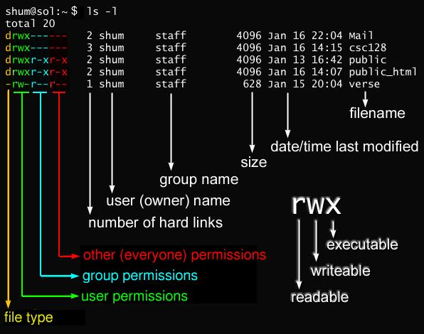

Slide 16
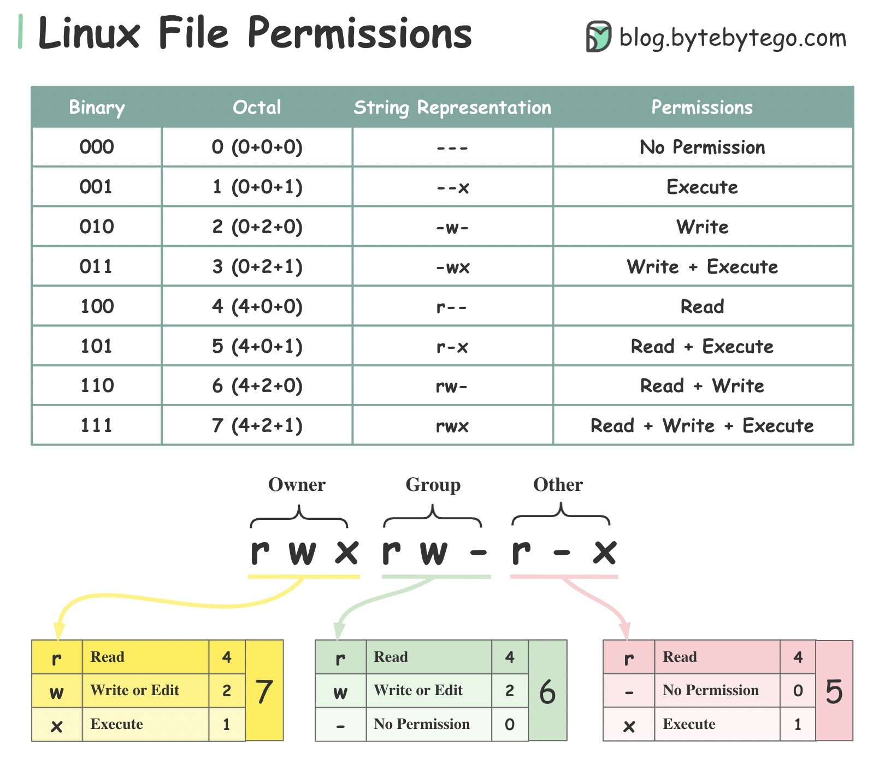

Slide 17
chmod
change the permissions of a file or folder.
Syntax : chmod <groupName>-<permissionName> <fileName>
Eg:
There are 2 ways
1. Absolute mode 2. Symbolic mode
Absolute node
file permissions are represented as a three-digit octal number.
Eg:

Slide 18
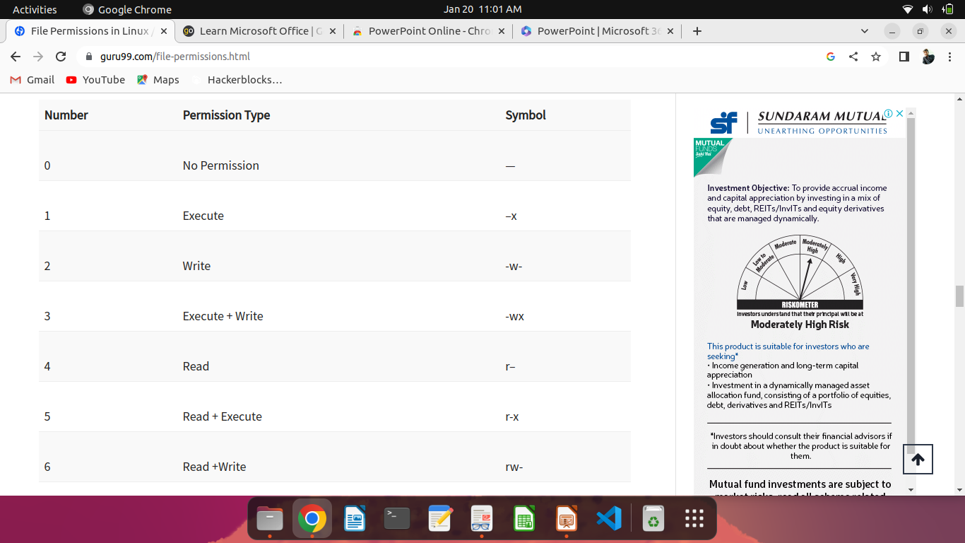

Slide 19
Symbolic node
file permissions are represented as a three-digit octal number.
Eg:

